Slide 1
So Many Books, So Little Time Web Scraping Good Reads
Sunanda Mishra

Slide 2
Agenda
What is GoodReads?
Why scrape it?
How to scrape it?
Preview: What to do with scraped data?
Future studies with data

Slide 3
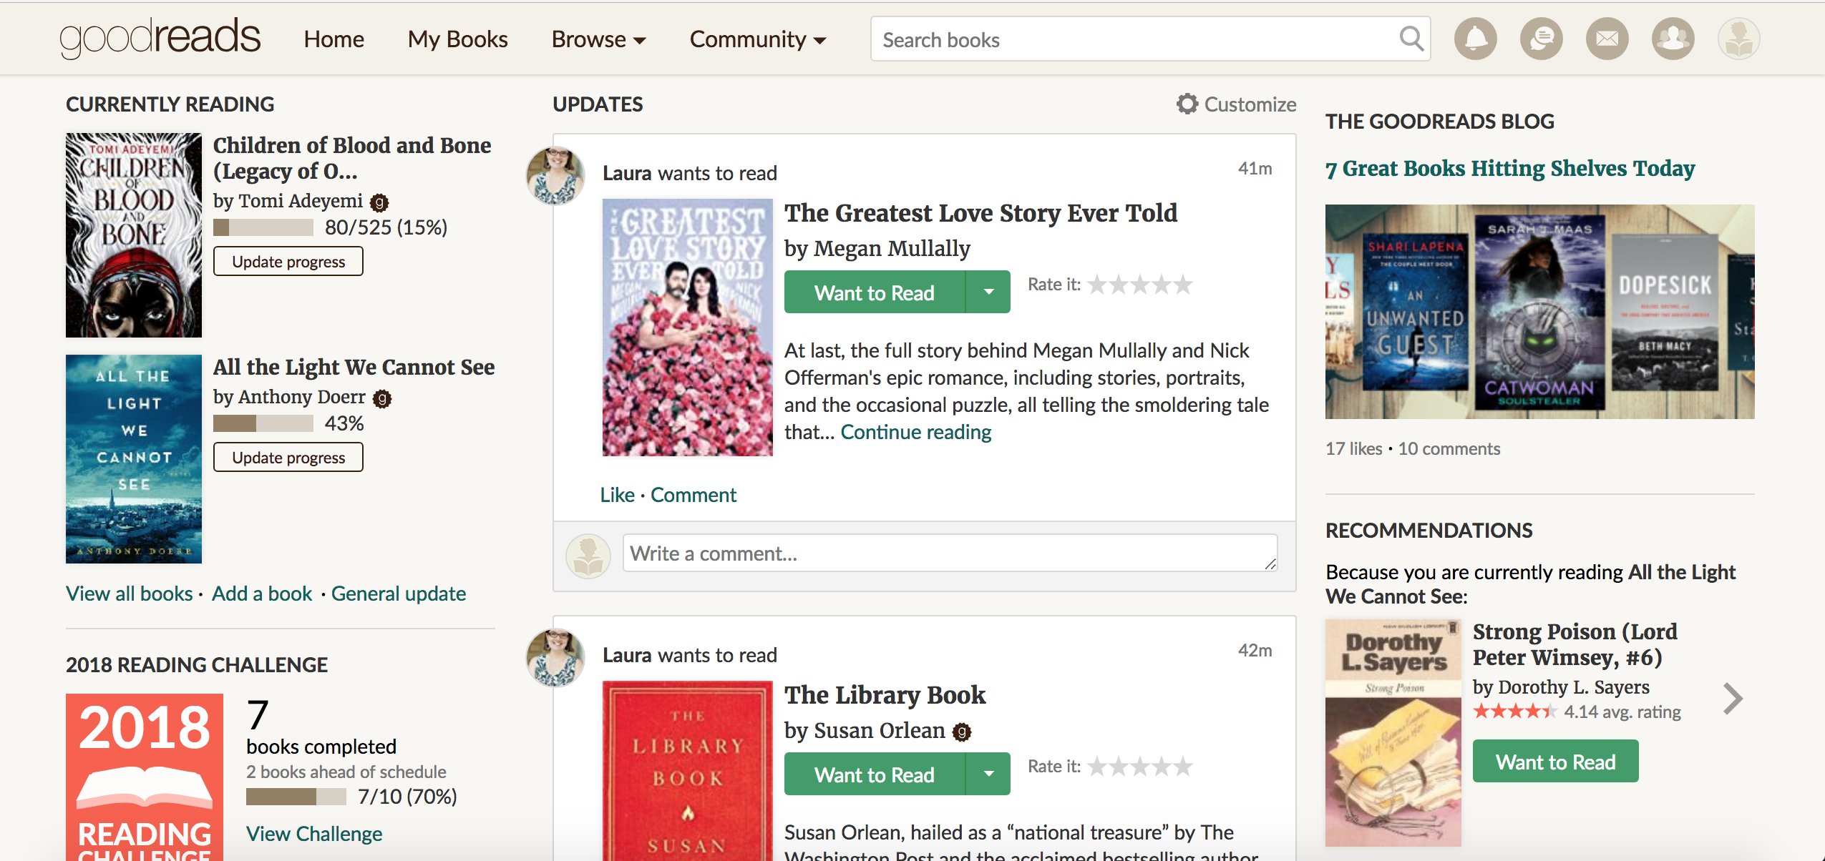
So…you like to read

Slide 4
Why Scrape it?
TONS of great data
There are more than 10,500 bookclubs on GoodReads!
Most clubs are made up of 1 person!!
Bookclub Moderators:
Helpful to know how to get your club up and running
Bookclub Members:
Helpful to know which bookclub to choose

Slide 5
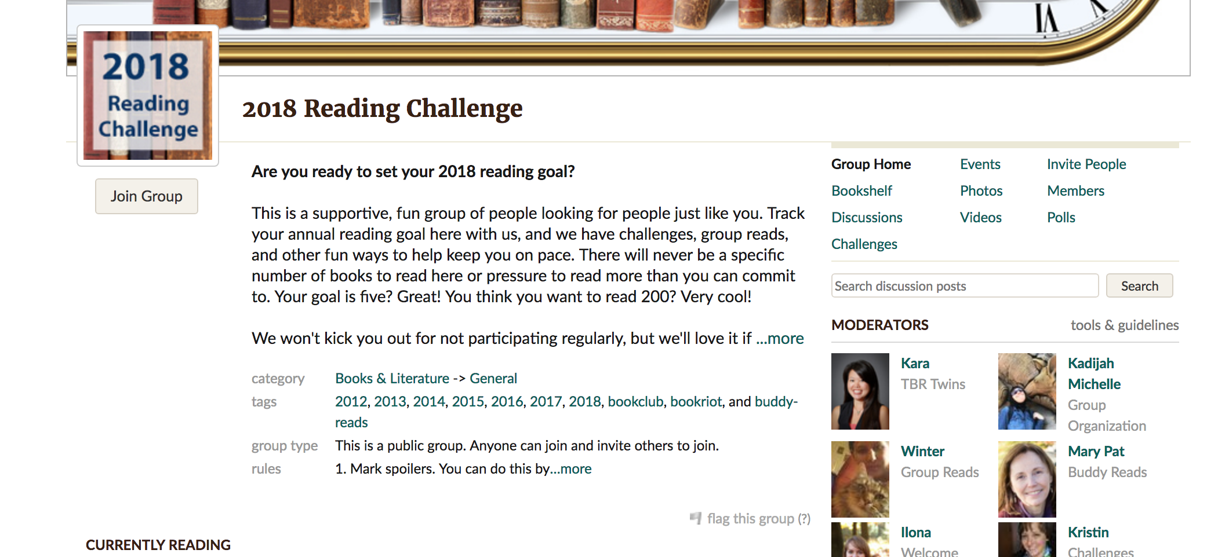
What does a bookclub’s page look like?

Slide 6
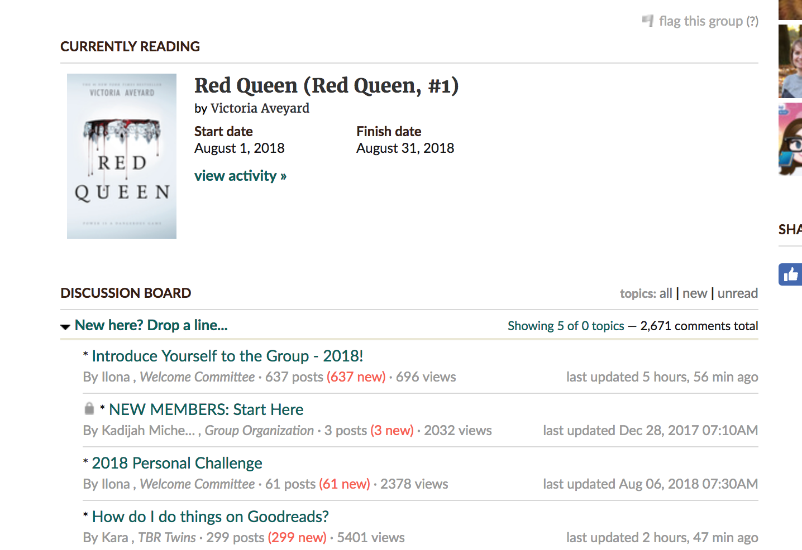
What does a bookclub’s page look like?

Slide 7
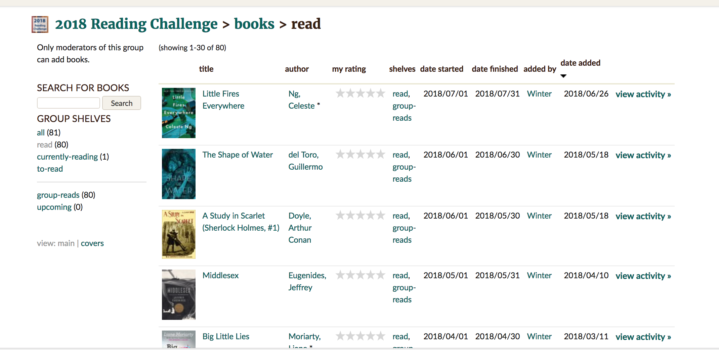
What does a bookclub’s page look like?

Slide 8
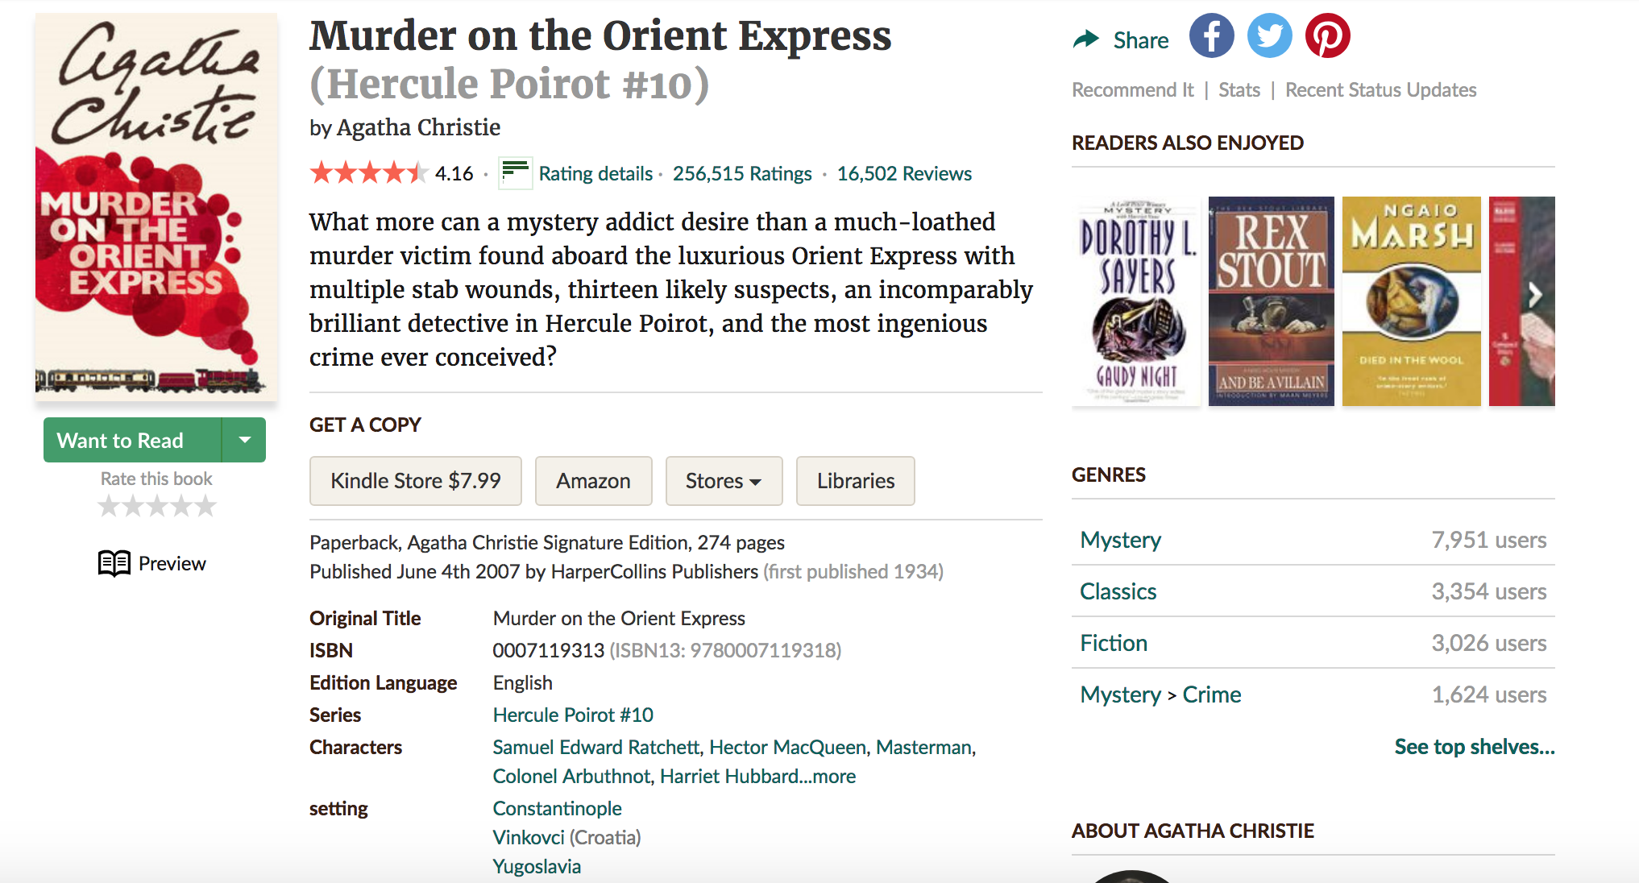
What does a book’s page look like?

Slide 9
How to scrape
3 Main Spiders:
Scrape the bookclub’s page
Group Name, Number of Members, currently reading, location, tags, group type
1800 bookclubs
Scrape the bookshelf
Group name, book titles
Scrape the books
Number of ratings, what the rating is, number of pages in the book, year published

Slide 10
What to do with scraped data?
How big are most book clubs?
Do larger and smaller book clubs behave differently?
Compare average book rating
Compare popularity of books
Compare book length
Compare how recently published the book was

Slide 11
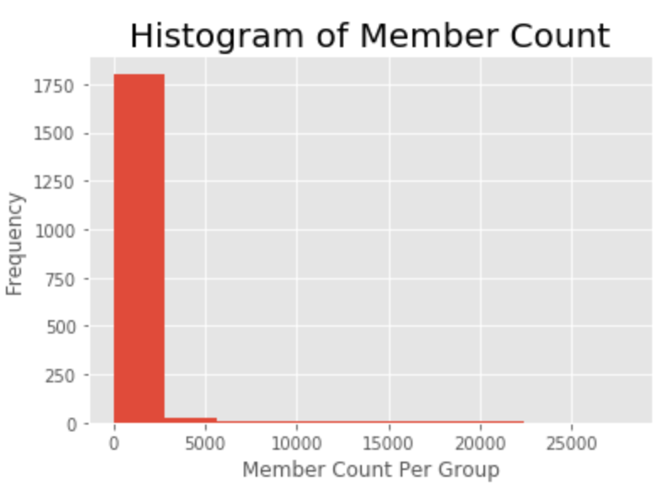
Member Count

Slide 12
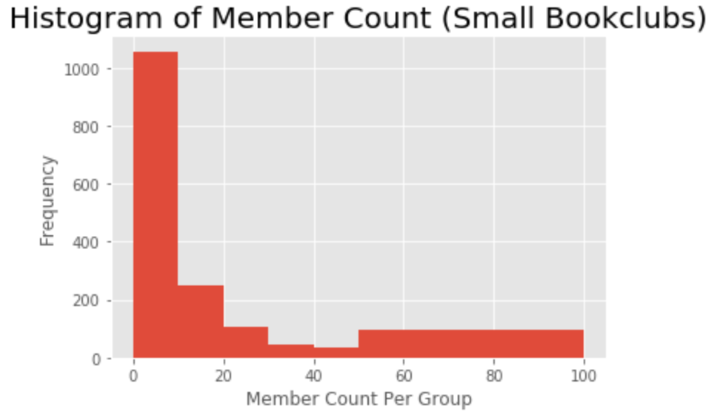
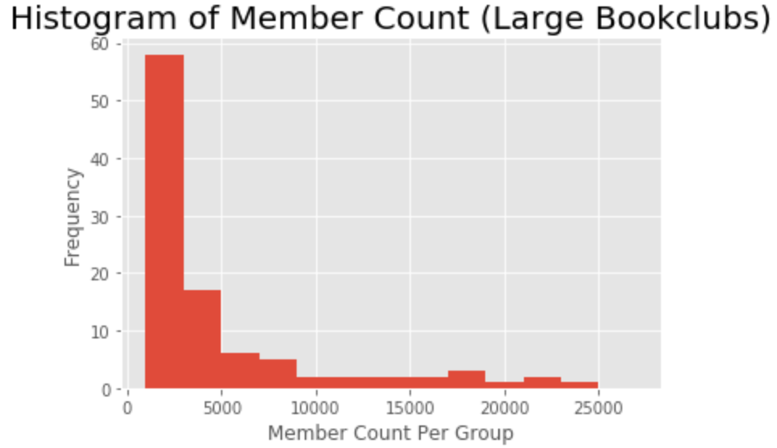


Member Count

Slide 13
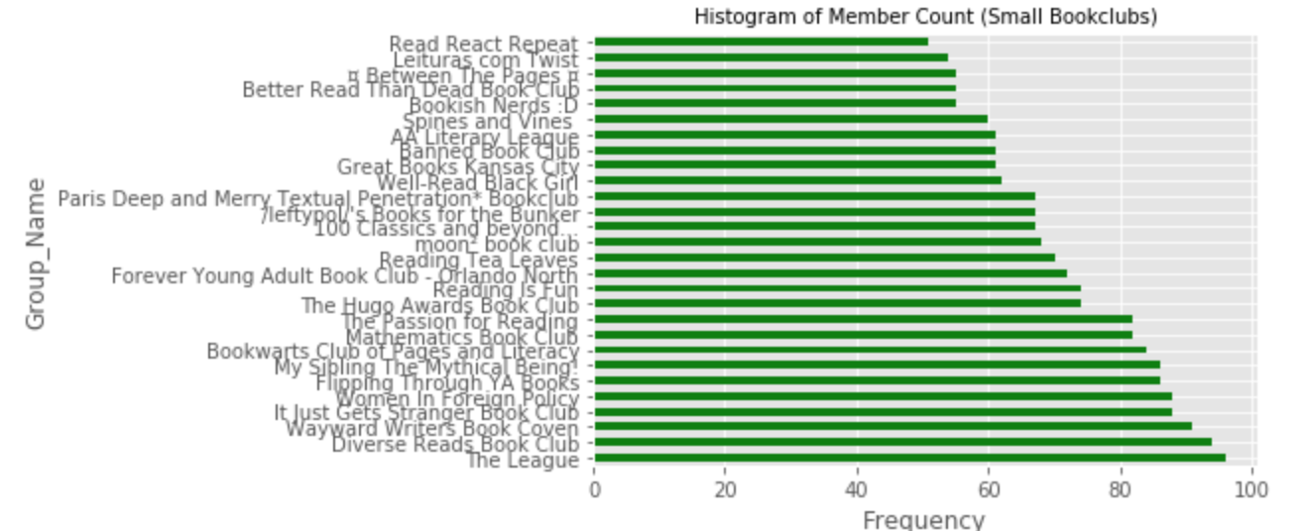
Examining Book Club Behavior

Slide 14
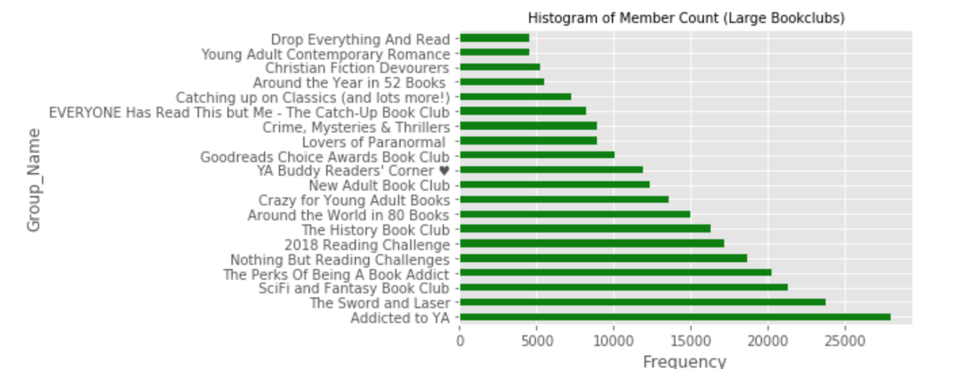
Examining Book Club Behavior

Slide 15
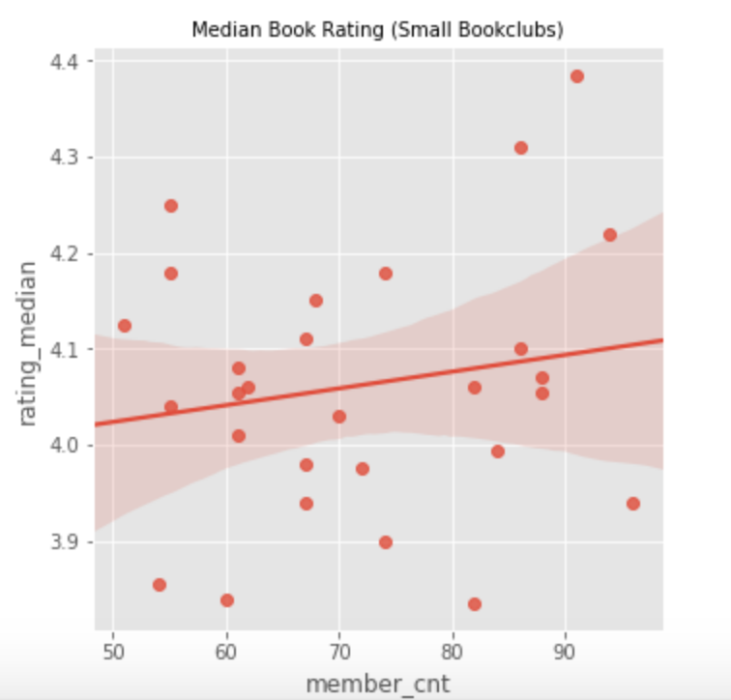
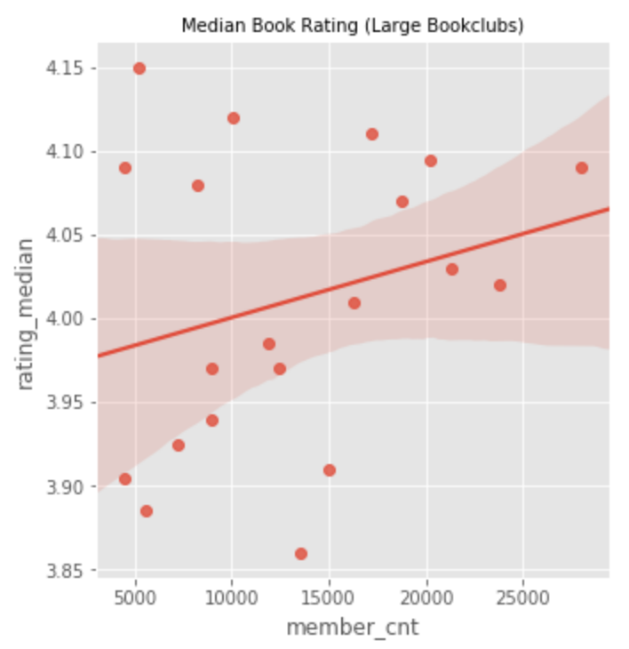
Book Club Behavior: Book Rating

Slide 16
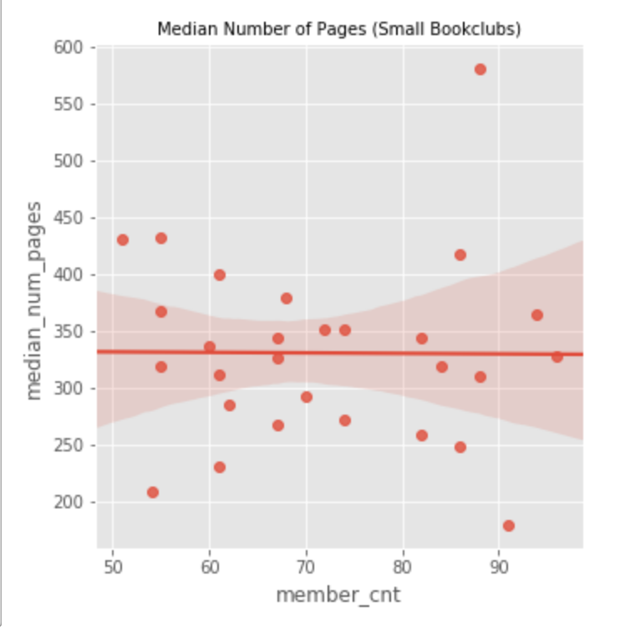
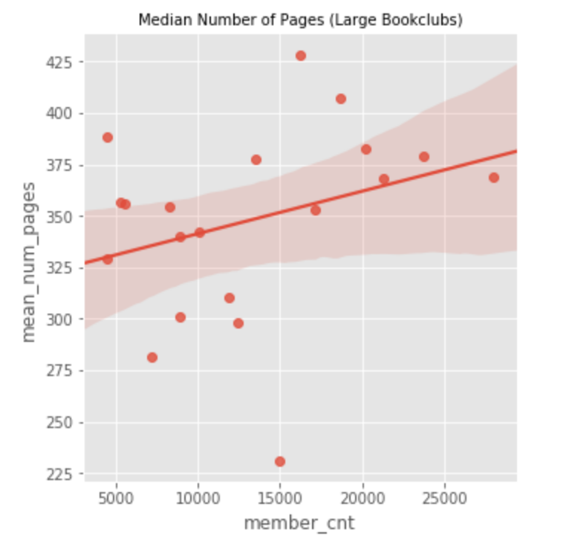
Book Club Behavior: Number of Book’s Pages

Slide 17
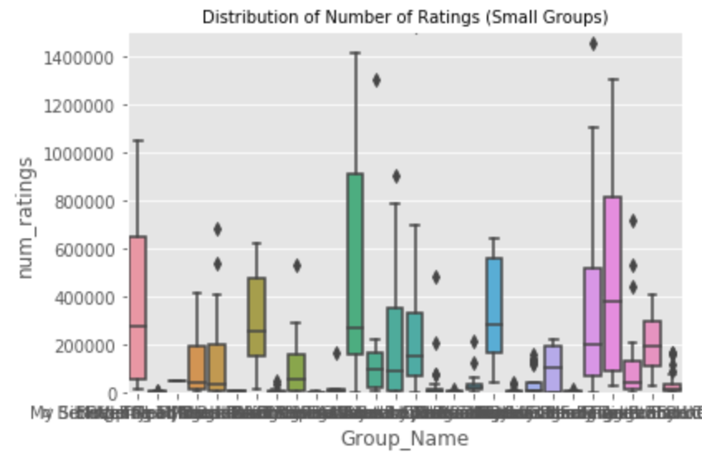
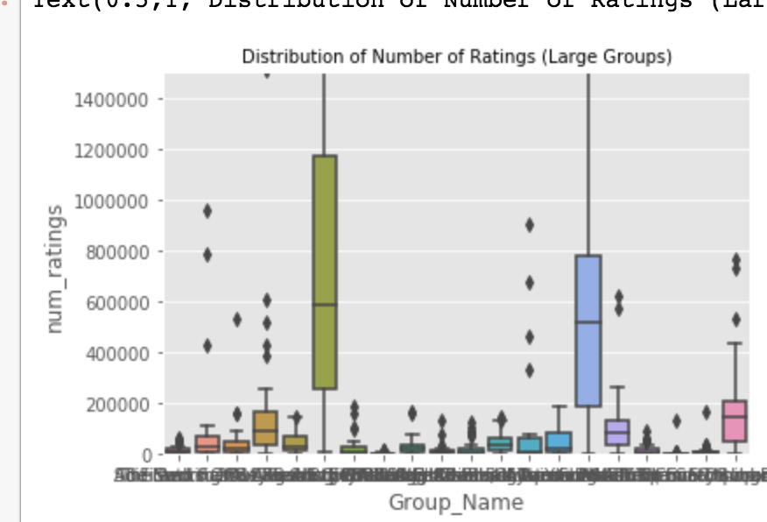
Book Club Behavior: Number of Ratings

Slide 18
Future Study Ideas
Do certain genres draw more members into their book club?
What makes a book club more likely to have a lot of discussions?
What books are repeatedly selected for book club readings? What are characteristics of these books?

